Slide 1
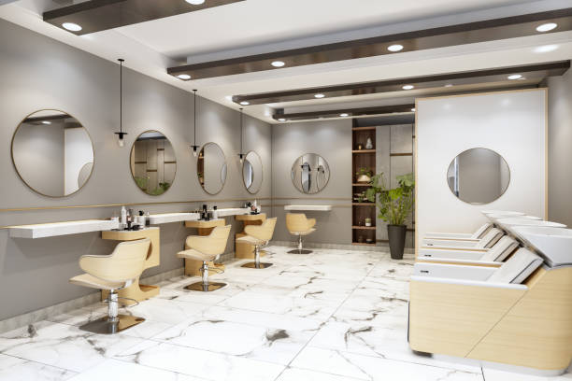
BARBERSHOP/SALON RESERVATION SYSTEM WITH A REAL-TIME UPDATE OF THE NUMBER OF CUSTOMERS IN THE SALON
Presented by: Supervised by:
Gacwe Daniel Nyere Mr. Karanja

Slide 2
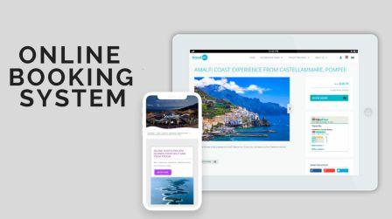
INTRODUCTION
WHAT IS AN APPOINTMENT SYSTEM?
Appointment scheduling solution/ appointment booking system/ appointment management software
Allows service providers to handle appointments more easily
An appointment management solution may include booking via a
Web app
Mobile app

Slide 3
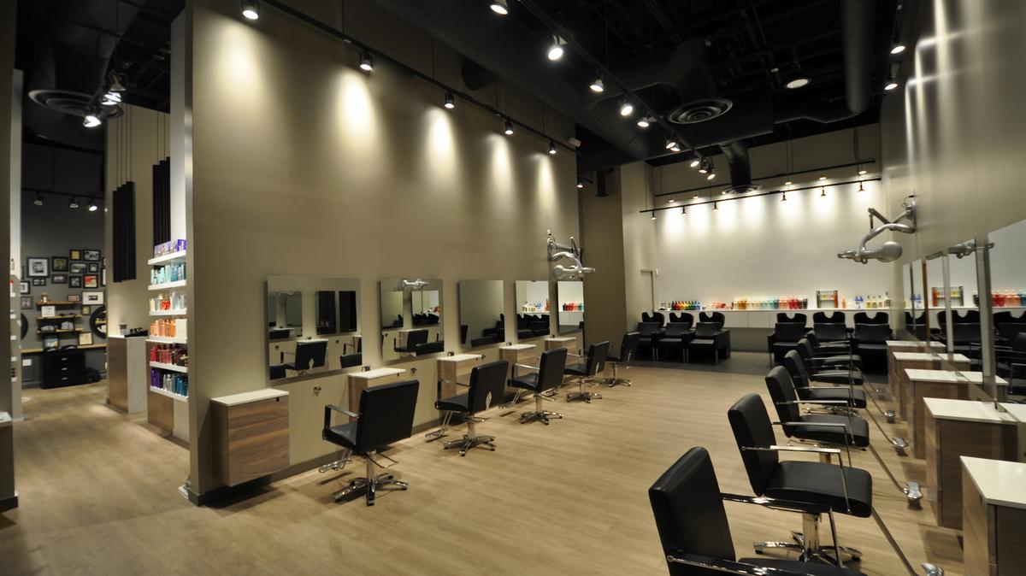
INTRODUCTION
WHAT IS A SALON/BARBERSHOP?
Is an establishment where a hairdresser conduct trade
Barbershop and salon businesses are rapidly growing industries across the country
Reservation System can boost customer and barber satisfaction in a shop

Slide 4
PROBLEM STATEMENT
There is need for generalised salon Application
Customers are becoming cognizant of time management
Some of the problems in salons include:
Limited working time
Time wastage (Waiting in line)
Inconveniences to the customers (Closing and opening)
Crowding (Against the Stipulated COVID rules)

Slide 5
Justification
“Always on” service
Increased Bookings
Increased Income
Time saving
Better Customer Satisfaction
Need for better online payment system

Slide 6
OBJECTIVES
MAIN OBJECTIVE
To design, implement and test an online barber/salon reservation system, with a real-time update of the number of customers in the shop.
SPECIFIC OBJECTIVES
To design and implement a web application and database
To design and implement a mobile version of the application
To design, implement and test a device that determines client occupancy number in a barbershop at any given time and relays this data to the application for remote use by potential customers
To establish a remote link between the application and the customer counter device

Slide 7
EXPECTED CONTRIBUTION
The project focusses primarily on:
The use of a WEB based appointment systems to efficiently run salons and barbershops
The use of a Mobile based appointment systems to efficiently run salons and barbershops
The use of microcontroller to determines client occupancy numbers in a barbershop at any given time still to promote efficiency

Slide 8
Literature review

Slide 9
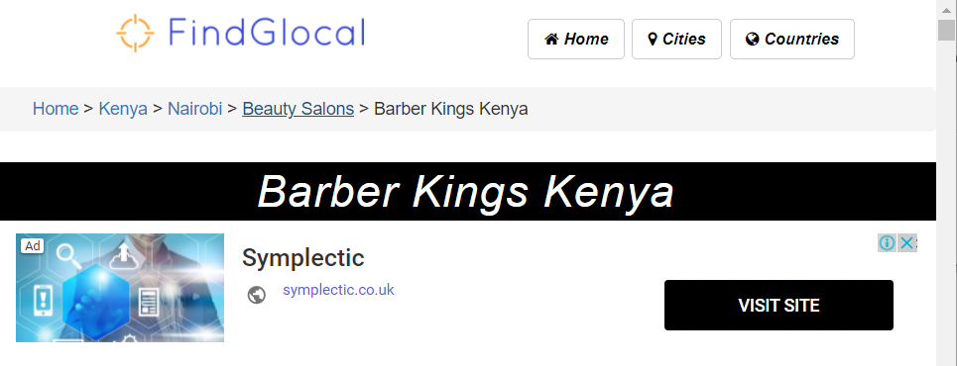
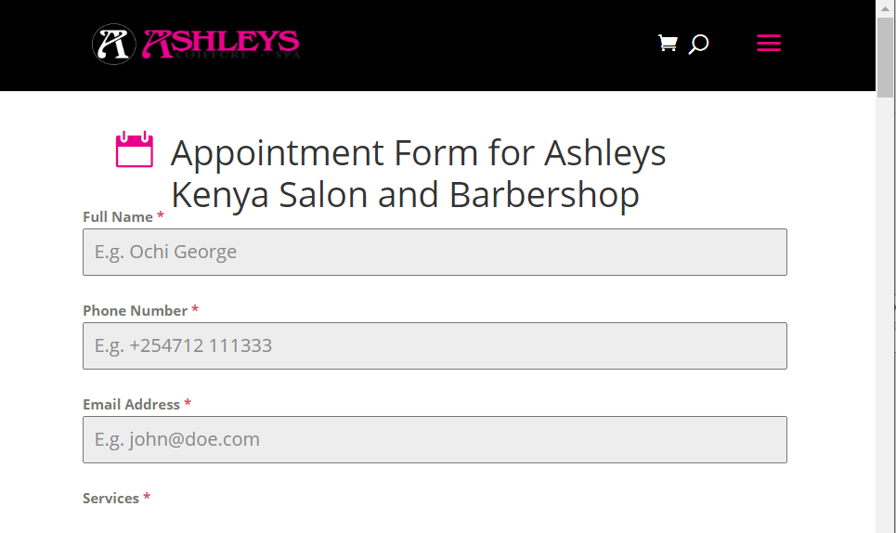
EXISTING systems
In Kenya:
Barber Kings Kenya
Ashleys Kenya

Slide 10
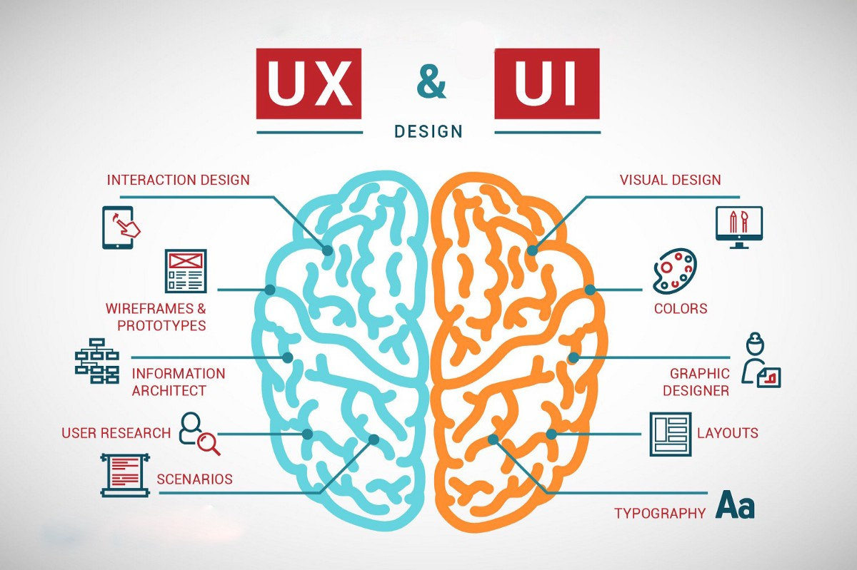
Problems with current systems
Salon Specific
Poor User Interface

Slide 11
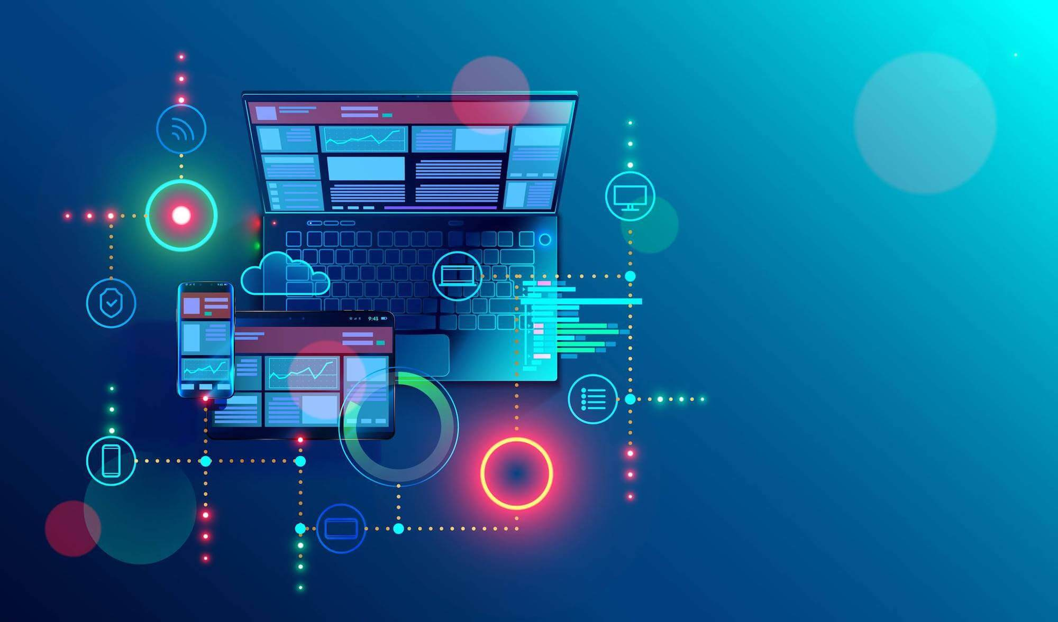
Web development
Web development is the process of using several technologies to create a static or dynamic webpage or web application on the internet
The development of a website can be divided into two sections
Front End
Where the look and feel of the site are created
Tools used include
Html
CSS
JavaScript
Bootstrap
Back End
The Server side responsible for storing and manipulating data. Unseen by user
Tools used include
XAMPP
PHP Framework
PHP
Database

Slide 12
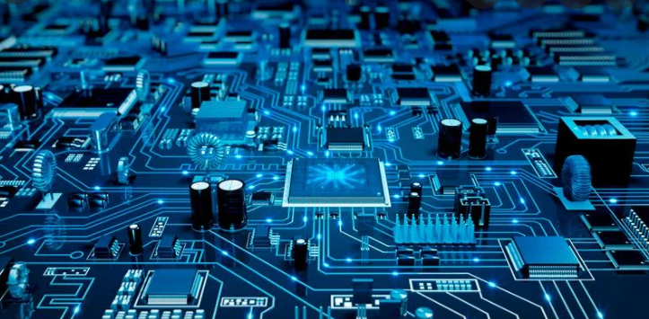
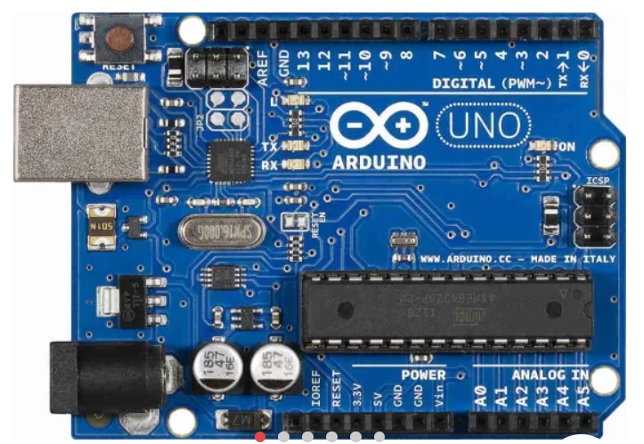
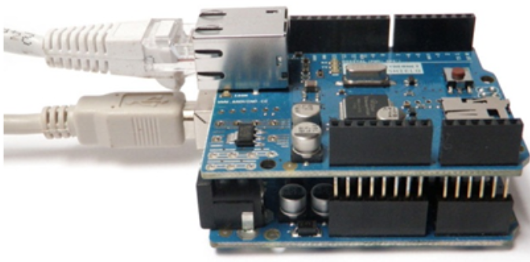
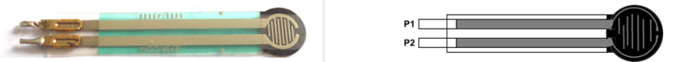
Hardware development
Arduino Ethernet Shield
Connects the board to the internet; facilitates remote connectivity
Arduino
Serves as an open-source platform for creating electronic projects.
Pressure Sensitive Resistor
Resistor that exhibits a decrease in resistance as the force applied to the active sensing surface increases

Slide 13
methodology

Slide 14
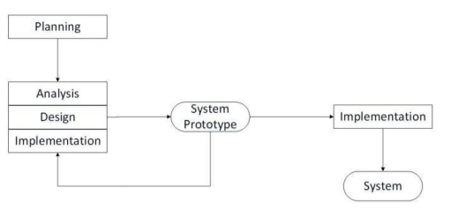
Web development
Prototype model will be used
Prototype of a final system, is produced, tested, and modified as needed until an acceptable prototype is obtained

Slide 15
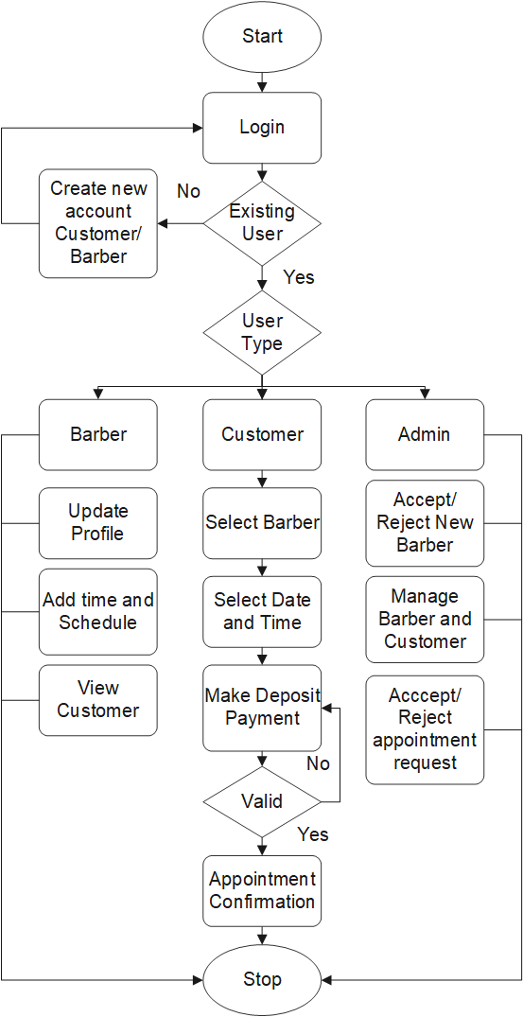
Flowchart design

Slide 16
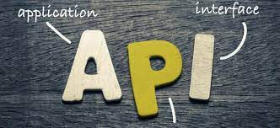
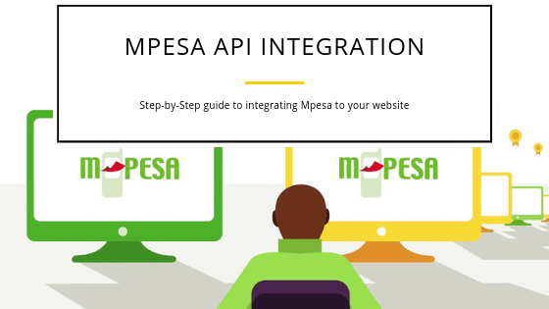

API
Set of protocols for creating and integrating software applications
Why?
speed up and lower the cost of application development
Easier and fast communication of services in app
Lipa na M-Pesa API
Allows developers to integrate Safaricom payment for Business to Customers
Google Calendar API
To integrate full calendar data and functionality into their apps

Slide 17
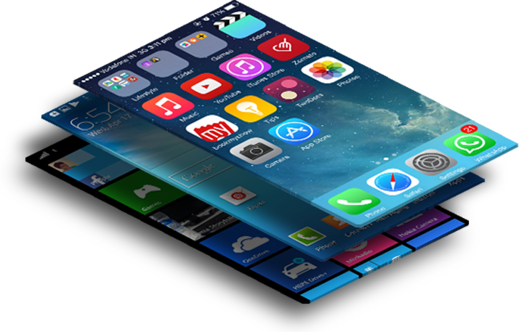

Mobile application Development
Process of creating software applications that run on a mobile device
There are various Frameworks used in transforming a Web App to Mobile App
J-Query Framework
Comes with
Widget library that translates semantic HTML into a gesture-friendly format
Good graphical components which improves user friendliness

Slide 18
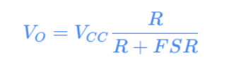
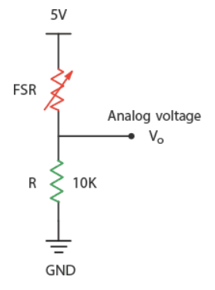
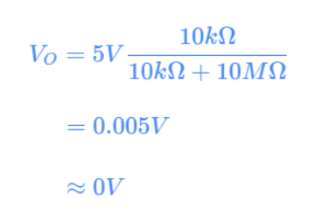
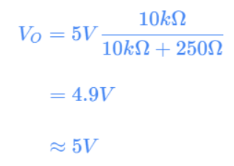
Hardware design
Customer counter circuit
Remote Communication
Arduino Ethernet shield facilitates remote communication through a router

Slide 19
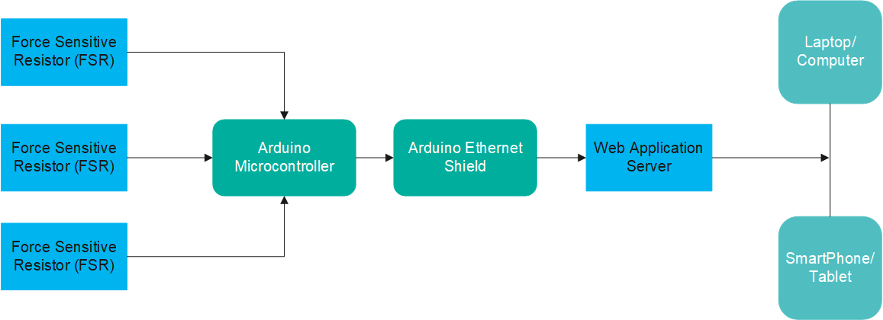
Block diagram

Slide 20
EXPECTED RESULTS
The Application will be useful to both clients who prefer making an appointment and those that just show up without an appointment.
The web pages shall be designed in a simple user-friendly manner.
It will be an excellent solution to the country's current challenges of time wastage in salons

Slide 21
PROJECT TIMEPLAN
ACTIVITY | SEM 1 |  |  |  | SEM 2
 | MAY | JUNE | JULY | AUG | SEPT | OCT | NOV | DEC
DOCUMENTATION
RESEARCH
PROGRESS REPORT 1
PROPOSAL WRITING
PROPOSAL PRESENTATION
DESIGN AND CODING
PROGRESS REPORT 2
HARDWARE CONFIGURATION AND TESTING
PROJECT REPORT WRITING
PROGRESS REPORT 3
FINAL PRESENTATION AND DEMONSTRATION

Slide 22
BUDGET
ITEM | QUANTITY | PRICE PER UNIT | TOTAL
Arduino Uno | 1 | 1,500 | 1,500
Arduino Ethernet Shield | 1 | 1,500 | 1,200
Pressure Resistor | 4 | 6,000 | 6,000
Resistor | 8 | 25 | 200
PCB | 1 | 500 | 500
Miscellaneous |  | 1,000 | 1,000
TOTAL |  |  | 10,500

Slide 23
THANK YOU!
Presented by: Supervised by:
Gacwe Daniel Nyere Mr. Karanja

Slide 24
QUESTIONS?

